Slide 1
1 THESSAOLIANS

Slide 2
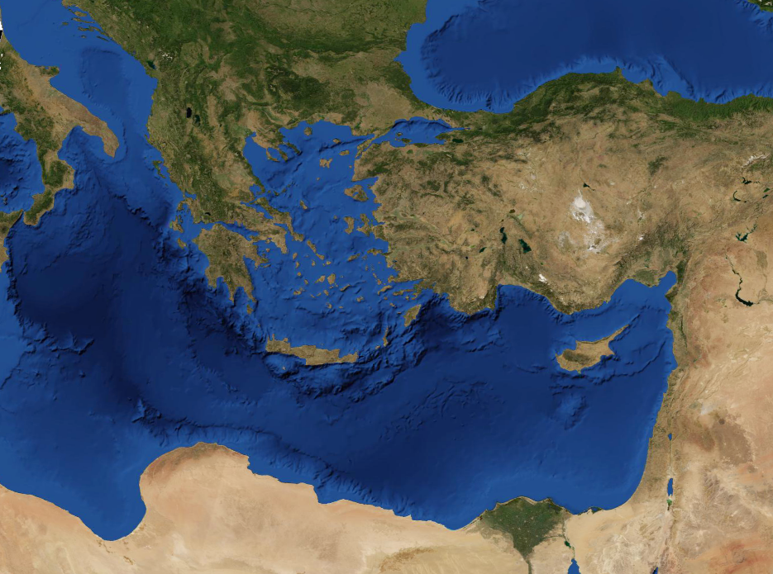
1 THESSAOLIANS
Rome
Thessalonica
Byzantium
Berea
Via Appia
Sea Route
Via Egnatia

Slide 3
1 THESSAOLIANS
These were more fair-minded than those in Thessalonica, in that they received the word with all readiness, and searched
the Scriptures daily to
find out whether these
things were so.
Acts 17.11

Slide 4
1 THESSAOLIANS
Work of faith ~ chapter 1
Labor of love ~ chapter 2
Patience of hope ~ chapter3

Slide 5
1 THESSAOLIANS
And they went out and preached everywhere, the Lord working with them and confirming the word through the accom-
panying signs. Amen.
Mark 16.20

Slide 6
1 THESSAOLIANS
Bold ~ parrēsiazomai – to speak freely; hold nothing back

Slide 7
1 THESSAOLIANS
Taken away ~ aporphanizō – apo (away from) + orphanos (fatherless)

Slide 8
1 THESSAOLIANS
And may the Lord make you increase and abound in love to one another and to all, just as we do to you,
To ~ not pros (to) but eis (into)
1 Thessalonians 3.12

Slide 9
1 THESSAOLIANS
Sexual immorality (v. 3) ~ porneia – premarital sex, adultery, pornography, self-gratification – illicit sex in all its forms

Slide 10
1 THESSAOLIANS
Caught up ~ harpazō ~ to snatch away
Vulgate ~ rapio

Slide 11
1 THESSAOLIANS
Form (KJV, appearance; NIV, kind) eidos – anything that remotely looks like evil

